Slide 1
A Presentation on HTML, CSS & JAVASCRIPT

Slide 2
HTML
What is HTML?
HTML stands for Hypertext Markup Language is a standard markup language for documents designed to be displayed in a web browser. It used to design the front-end part of the web page. It defines the structure of a web page and tell the browser to how to display the content. It contains a series of element. The elements in HTML is represented by tags e.g.- <html>……</html>, <head>……</head>, <body>……</body>,etc. In these tags we write our content that is to be displayed on the web page. The browser does not display the tags in the web page it only displays the contents.

Slide 3
Elements in HTML
The <html> element is the root element of an HTML page
The <head> element contains meta information about the document
The <title> element specifies a title for the document
The <body> element contains the visible page content
The <h1> element defines a large heading
The <p> element defines a paragraph

Slide 4
An example of a HTML document
<!DOCTYPE html> <html> <head> <title>Page Title</title> </head> <body> <h1>My First Heading</h1> <p>My first paragraph.</p> </body> </html>

Slide 5
What are HTML Tags and Attributes?
What Are HTML Tags?
Tags are used to mark up the start of an HTML element and they are usually enclosed in angle brackets. An example of a tag is: <h1>.
Most tags must be opened <h1> and closed </h1> in order to function.
What are HTML Attributes?
Attributes contain additional pieces of information. Attributes take the form of an opening tag and additional info is placed inside.
An example of an attribute is:
<img src="mydog.jpg" alt="A photo of my dog.">
In this instance, the image source (src) and the alt text (alt) are attributes of the <img> tag.

Slide 6
How to add Links in HTML?
The Anchor Tag
The <a> (or anchor) opening tag is written in the format:
<a href="http://www.google.com">Your Link Text Here </a>

Slide 7
How To Add Images In HTML?
The <img> tag normally is written as follows:
<img src="yourimage.jpg" alt="Describe the image" height="X" width="X">

Slide 8
How To Make an HTML List?
In web design, there are 3 different types of lists which you may wish to add to your site.
1. Ordered List
<ol> This is an ordered list of contents.
2. Unordered List
<ul> unordered list. This is better known as a bullet point list and contains no numbers.
3. Definition List
definition list <dl>

Slide 9
Example of Ordered, Unordered and Definition List
<ol>
<li>An item </li> <li>Another item </li> <li>Another goes here</li>
</ol>
<ul>
<li>This is </li> <li>An Unordered </li>
<li>List </li>
</ul>

Slide 10
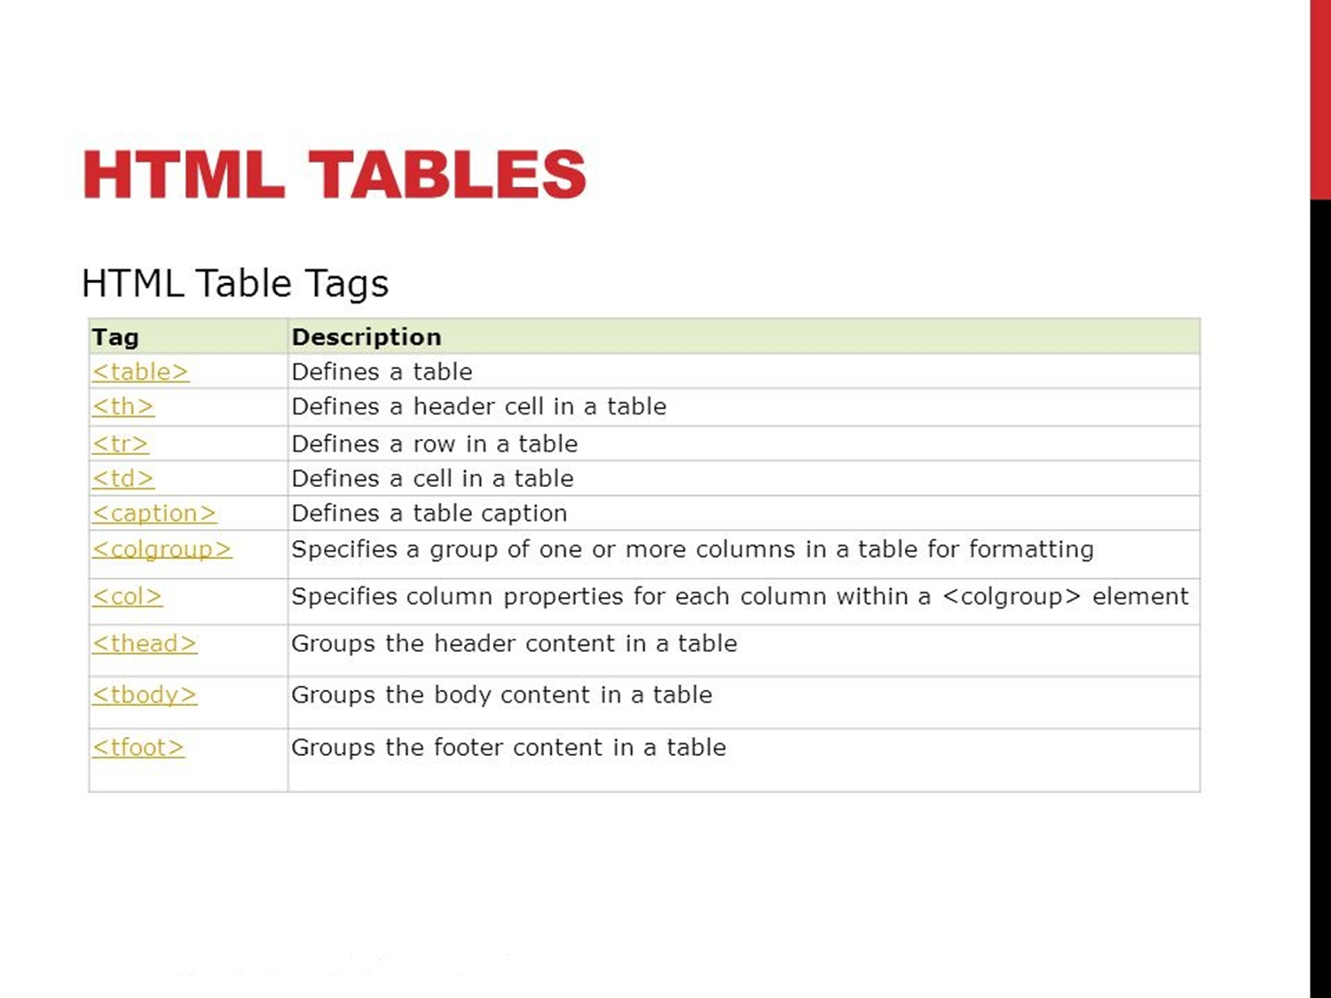
HTML Tables

Slide 11
CSS
What is CSS?
CSS stands for Cascading Style Sheets is a language that describes the style of a HTML document that how the elements should be displayed on the web pages. It can be used to control the layout of multiple web pages all at once. It is used to define styles for your web pages, including the design, layout and variations in display for different devices and screen sizes.

Slide 12
Types of CSS
There are three types of CSS-
Inline CSS :- Inline CSS refers to CSS found in an HTML file. It is found in the head of a document between style tags. Inlining CSS simply means putting your CSS into your HTML file instead of an external CSS file.
Internal CSS :- The Internal Style Sheet is used to add a unique style for a single document. It is defined in <head> section of the HTML page inside the <style> tag.
External CSS :- An External Style Sheet is a file containing only CSS syntax (no document content or elements) and should carry a MIME type of "text/css." The style information is not explicitly tied directly to the document's elements, so Selector syntax is used to specify what styles attach to which portions of the document tree.

Slide 13
Example Of Inline CSS
<!DOCTYPE html>
<html>
<body>
<h1 style="color: blue;">This is a Blue Heading</h1>
</body>
</html>

Slide 14
Example Of Internal CSS
<!DOCTYPE html>
<html>
<head>
<style>
body {background-color: powderblue;}
h1 {color: blue;}
p {color: red;}
</style>
</head>
<body>
<h1>This is a heading</h1>
<p>This is a paragraph.</p>
</body>
</html>

Slide 15
Example Of External CSS
<!DOCTYPE html>
<html>
<head>
<link rel="stylesheet" href="styles.css">
</head>
<body>
<h1>This is a heading</h1>
<p>This is a paragraph.</p>
</body>
</html>

Slide 16
# styles.css
body {
background-color: powderblue;
}
h1 {
color: blue;
}
p {
color: red;
}

Slide 17
How to add borders in CSS?
The border-style property specifies what kind of border to display.
The following values are allowed:
dotted - Defines a dotted border
dashed - Defines a dashed border
solid - Defines a solid border
double - Defines a double border
groove - Defines a 3D grooved border. The effect depends on the border-color value
ridge - Defines a 3D ridged border. The effect depends on the border-color value
inset - Defines a 3D inset border. The effect depends on the border-color value
outset - Defines a 3D outset border. The effect depends on the border-color value
none - Defines no border
hidden - Defines a hidden border
The border-style property can have from one to four values (for the top border, right border, bottom border, and the left border).

Slide 18
How to add margins in CSS?
The CSS margin properties are used to create space around elements, outside of any defined borders.
With CSS, you have full control over the margins. There are properties for setting the margin for each side of an element (top, right, bottom, and left).
CSS has properties for specifying the margin for each side of an element:
margin-top
margin-right
margin-bottom
margin-left

Slide 19
Example to set margins in CSS
<!DOCTYPE html>
<html>
<head>
<style>
div {
border: 1px solid black;
margin-top: 100px;
margin-bottom: 100px;
margin-right: 150px;
margin-left: 80px;
background-color: lightblue;
}
</style>
</head>
<body>
<h2>Using individual margin properties</h2>
<div>This div element has a top margin of 100px, a right margin of 150px, a bottom margin of 100px, and a left margin of 80px.</div>
</body>
</html>

Slide 20
CSS Box Model
All HTML elements can be considered as boxes. In CSS, the term "box model" is used when talking about design and layout.
The CSS box model is essentially a box that wraps around every HTML element. It consists of: margins, borders, padding, and the actual content.
Explanation of the different parts:
Content - The content of the box, where text and images appear.
Padding - Clears an area around the content. The padding is transparent.
Border - A border that goes around the padding and content.
Margin - Clears an area outside the border. The margin is transparent.

Slide 21
Example of CSS Box Model
<!DOCTYPE html>
<html>
<head>
<style>
div {
background-color: lightgrey;
width: 300px;
border: 15px solid green;
padding: 50px;
margin: 20px;
}
</style>
</head>
<body>
<h2>Demonstrating the Box Model</h2>
<p>The CSS box model is essentially a box that wraps around every HTML element. It consists of: borders, padding, margins, and the actual content.</p>
<div>Hello</div>
</body>
</html>

Slide 22
CSS Flexbox
CSS Flexible Box Layout, commonly known as Flexbox, is a CSS3 web layout model. It is in the W3C's candidate recommendation stage. The flex layout allows responsive elements within a container to be automatically arranged depending upon screen size.

Slide 23
JavaScript
JavaScript is a scripting or programming language that allows you to implement complex things on web pages. Every time a web page does more than just sit there and display static information for you to look at , displaying timely content updates, interactive maps, animated 2D/3D graphics, scrolling video jukeboxes, etc you can bet that JavaScript is probably involved.

Slide 24
So what can it really do?
The core client-side JavaScript language consists of some common programming features that allow you to do things like:
Store useful values inside variables. In the above example for instance, we ask for a new name to be entered then store that name in a variable called name.
Operations on pieces of text (known as "strings" in programming). In the above example we take the string "Player 1: " and join it to the name variable to create the complete text label, e.g. ''Player 1: Chris".
Running code in response to certain events occurring on a web page. We used a click event in our example above to detect when the button is clicked and then run the code that updates the text label.
And much more!

Slide 25
How do you add JavaScript to your page?
Internal JavaScript
<script> // JavaScript goes here </script>
External JavaScript
<script src="script.js" defer></script>
Inline JavaScript handlers
function createParagraph() { let para = document.createElement('p'); para.textContent = 'You clicked the button!'; document.body.appendChild(para); }

Slide 26
Script Loading Strategies
In the internal example, you can see this structure around the code:
document.addEventListener("DOMContentLoaded", function() { ... });

Slide 27
Async and Defer
For example, if you have the following script elements:
<script async src="js/vendor/jquery.js"></script> <script async src="js/script2.js"></script> <script async src="js/script3.js"></script>

Slide 28
Comments
As with HTML and CSS, it is possible to write comments into your JavaScript code that will be ignored by the browser, and exist simply to provide instructions to your fellow developers on how the code works (and you, if you come back to your code after six months and can't remember what you did). Comments are very useful, and you should use them often, particularly for larger applications.
There are two types:
A single line comment is written after a double forward slash (//), e.g.// I am a comment
A multi-line comment is written between the strings /* and */, e.g./* I am also a comment */

